Slide 1
Welcome to: Service Management (Reporting)
Duration
1 day
timings
09:30 – 16:30
Trainer name, details and email here

Slide 2

Housekeeping
AM breaks Lunch PM breaks
Graphics by Storyset

Slide 3
Troubleshooting
If I disconnect:
One of you will automatically become the host and when I return, I’ll resume the course.
Please don’t leave the session.
If you disconnect:
Don’t panic!
Re-join using your link.
Contact:
virtual.learningteam@qa.com
0203 908 2376
Chat link from your joining email

Slide 4
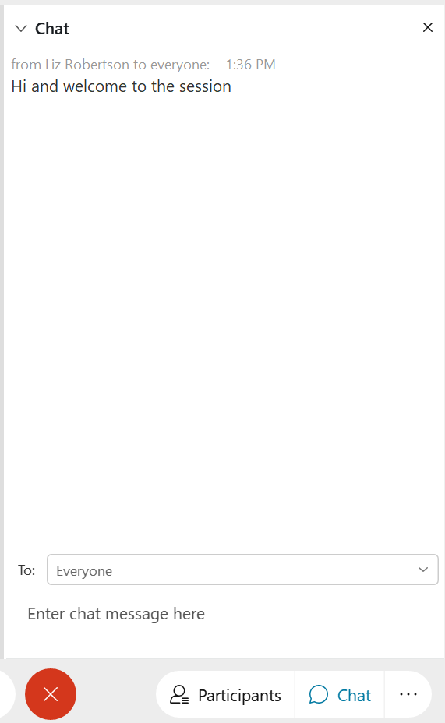
CHAT WINDOW
Ask and answer questions
Add comments
Notes:
Ask learners to send to Everyone, rather than just Host
Everyone then sees questions, answers and comments from everyone and feels more connected

Slide 5
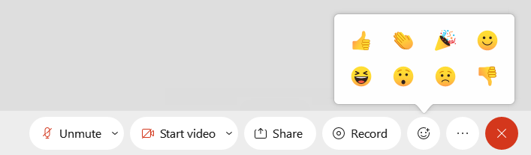
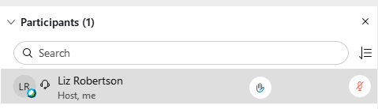
REACTIONS
AND
RAISED HANDS
Finding a topic interesting?
Got a question?
Notes:
Encourage learners to use Raised Hands and Reactions regularly to confirm understanding of a topic / ask a question / check in with you

Slide 6
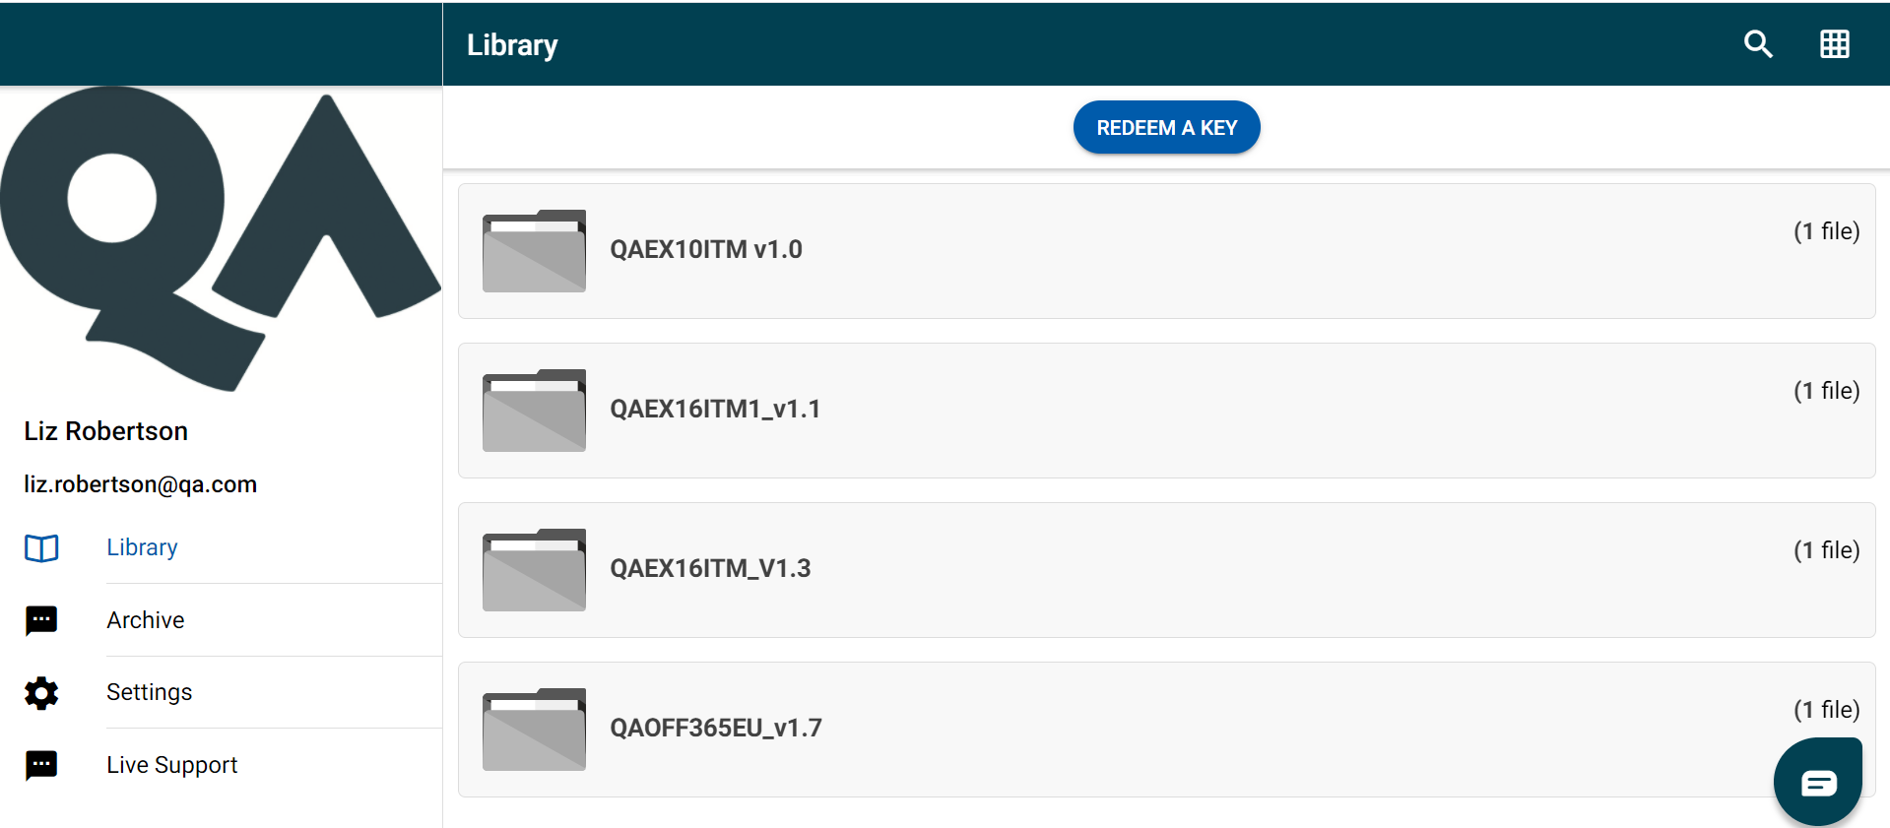
Visit www.mimeo.digital/#/
Create an account
REDEEM YOUR KEY: XXXX
DIGITAL
COURSEWARE

Slide 7
Course topics
What is data visualisation?
Types of visualisation
Decluttering visuals
Focusing key point attention
Create a visual narrative

Slide 8

Introductions
Name
Where do you work?
What do you currently do with data?
Graphics by Storyset

Slide 9

Questions?
Just ask!
Graphics by Storyset

Slide 10
Government
What sector do you work in?
Sales
Healthcare
Finance
Charity
Other
Transport
Education
IT

Slide 11

YOUR EXPERIENCE
Basic
Intermediate
Expert

Slide 12
Let’s Get Started…

Slide 13
Module 1: What is Data visualisation?
Why do we need a visual
Where can visuals be used

Slide 14
What is the primary purpose of data visualisation?
A: To make data look more appealing
B: To simplify complex data
C: To hide data anomalies
D: To confuse the audience
Fill in the blanks: Common graph types include _____ graphs, _____ graphs, scatter plots, and pie charts.
True or false? An infographic is an interactive tool used to build maps and spatial visuals.
Discuss what types of visualisations you need to build for your audience
Review
questions
Notes:
Name the four steps in the Insight Pyramid and place them in the correct order
Fill in the blanks: ‘To cultivate a data-driven mindset the organisation must have the right culture, the right structure and the right technology.’
What is the difference between data and information?
Match the numbers to the letters
1 & C
2 & A
3 & B

Slide 15
Module 2: Visualisation types
Tables and matrices
Graphs and Charts
Geographic Maps

Slide 16
Which software tools offer map visualisation capabilities?
A. Excel
B. Power BI
C. Photoshop
D. Word
True or false? You can plot data on a map visual if you have longitude and latitude coordinates.
Fill in the blanks: The matrix visualisation organises data into ____ and ____, just like a table, but it also includes additional dimensions for ____ or categorising the data.
Now that you know more, discuss what types of visualisations you need to develop for your audience.
Review
questions
Notes:
What key elements does data governance cover? Answers can include: Data collection, data quality, data management, privacy, compliance and data value
Name four steps that form part of the data lifecycle Answers can include: Generation, collection, processing, storage, management, analysis, visualisation and interpretation
What are BI and MI? Answers will vary but should be similar to: BI is used to define how an organisation is performing with customers and products. MI refers to how the organisation, processes and people are performing.
Give a definition of enterprise data. Answers will vary but should include some reference to centrally stored and managed. Also could include references to it being created by business processes, available when required, consistent (single source) for all to use if required, seen as valuable to the business.

Slide 17
Module 3: Decluttering visuals
What are the elements
Why do we need to declutter
How to remove distractions

Slide 18
Which of these are not chart elements?
A: Legend
B: Axes
C: Filters
D: Tooltips
Fill in the blanks: Eliminate decorative elements that do not contribute to understanding the data. Items often deemed unnecessary include backgrounds, ____, ____, or ____.
True or false? A large and varied colour palette is visually pleasing and helps convey the information effectively.
Now that you know more, discuss how you may declutter your visualisations from the previous exercise.
Review
questions
Notes:
What is data granularity? The level of detail in the data
Describe the difference between data type and data format Data type is the attribute that describes what the data is (and used for). Format is how the data appears
What is a dataset? Collection of data from data sources used for a data model and analysis
Name four quality metrics Answers can include accuracy, completeness, consistency, timeliness, availability, legitimacy and accessibility

Slide 19
Module 4: Focus key point attention
What are the key point of the story
Who is the audience
How to emphasise the key points

Slide 20
Why is simplifying complex data important in data storytelling?
A: To overwhelm the audience with information.
B: To make the data more difficult to understand.
C: To highlight only the critical insights and avoid distractions.
D: To impress the audience with the depth of the data.
Fill in the blanks: Using colours, labels, and ______ in visualisations helps focus on specific _____ points for emphasis.
True or false? Focused attention in data storytelling means oversimplifying the data to the point where important nuances are lost.
Now that you know more, discuss how you may make your visualisations from the previous exercise clearer and the type of focus you may need to use.
Review
questions
Notes:
You are creating a relationship between two tables. What attribute do the fields need to have? The same data type
Name four data types Answers can include text, number (and types), date (and date/time, time), Boolean, url
Describe a difference between quantitative and qualitative data Answers will vary but should include some reference to measured/counted and descriptive. May include Measures and Dimensions, discrete and continuous
Name two data scales Answers can include nominal, ordinal, interval or ratio
What is a dimension? Answer can include reference to keys, qualitative, categories/segments, used to describe facts, used in normalised data and relationships

Slide 21
Module 5: Create a visual narrative
Why do we need to comment?
What are narratives, commentaries, and callouts?
Types of elaborative and explanatory notes

Slide 22
In your data report, what is the purpose of highlighting key insights?
A: To draw attention to irrelevant information
B: To provide evidence for data manipulation
C: To facilitate a quick understanding of crucial findings
D: To confuse readers and make the report more challenging
Fill in the blanks: Presenting data within a narrative structure makes data visuals more _____ and relatable to the audience.
True or false? Elaborative notes provide context, highlight important points, or offer further insights to aid the audience.
Finally, discuss how you may annotate your visualisations discussed in the previous exercises and the type of notes you may need to use.
Review
questions
Notes:
What characteristics should a hypothesis have? Be testable, unbiased, concise and define the context
Name two types of analytics Answers can include descriptive, diagnostic, predictive or prescriptive
What is the data analytics lifecycle? Answers will vary but should include references to the process (and possibly steps) which form the route from business question/problem through data collection/prep, analysis, visuals and decision back to the business question
How can the central tendency in a dataset be calculated? Answers will likely include averages
Name three ways the spread of values can be measured Answers likely to include MIN/MAX, Deviation, Percentile/Quartile or Ranking
What makes a good data question? Be clear, concise and measurable

Slide 23
Let’s review

Slide 24
Course topics
What is data visualisation?
Types of visualisation
Decluttering visuals
Focusing key point attention
Create a visual narrative

Slide 25

What Are You going to…
...Stop?
...Continue?
...Start?

Slide 26
Congratulations and thank you!
You will receive your course attendance certificate via email.

Slide 27
Leaving the session?
Click FILE > Leave Training Session

